Slide 1
Priority Pass & Taxi App Integration
Customer Value Proposition
This solution transforms how Priority Pass members experience airport travel, turning fragmented booking into a single, intelligent journey.
The platform integration eliminates guesswork by providing complete journey timelines, ensuring users arrive with optimal time for both transportation and lounge access.
Whether starting with taxi or lounge booking, users are consistently offered the complete premium experience, maximizing both convenience and revenue opportunities.

Slide 2
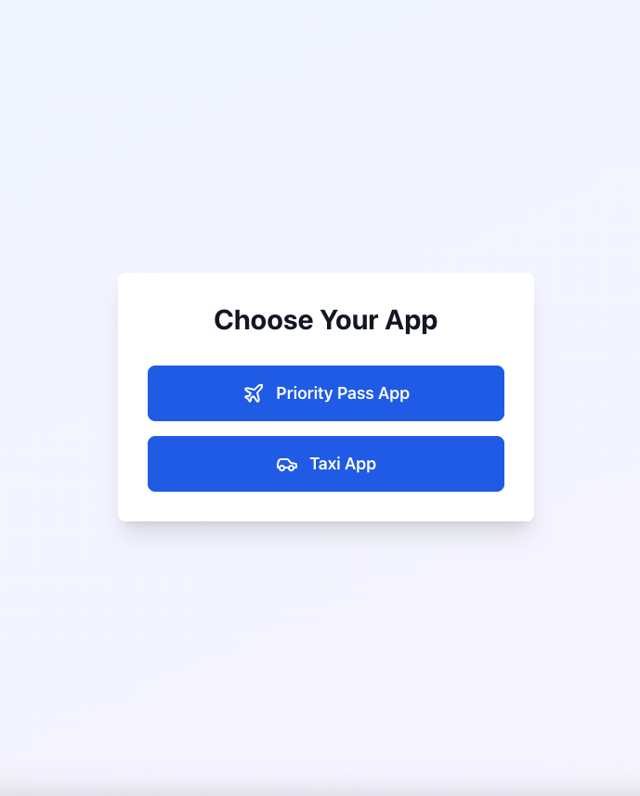
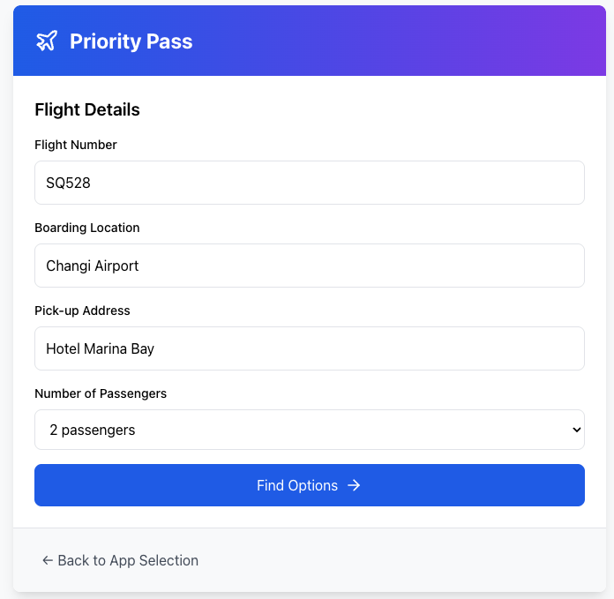

Slide 3
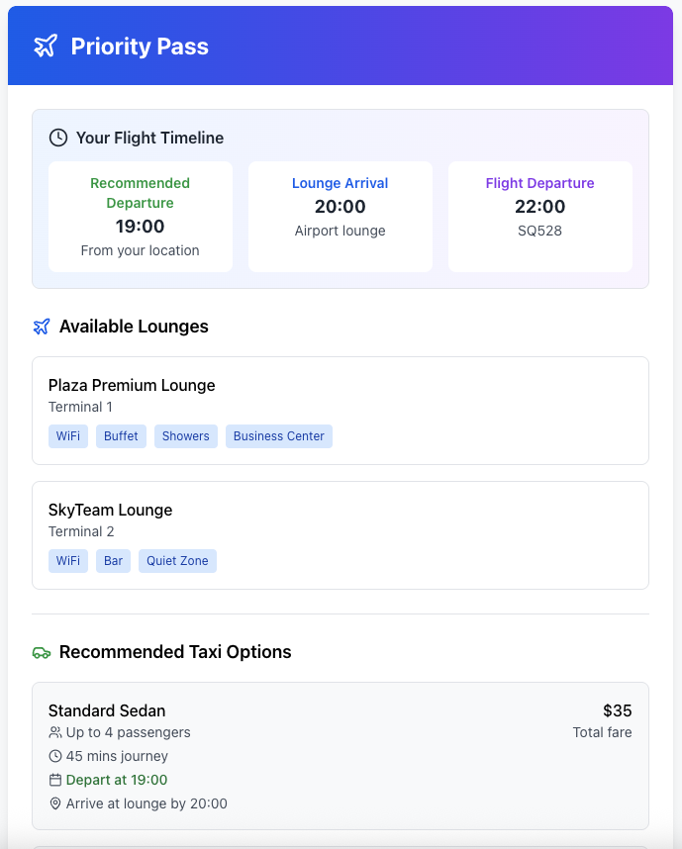
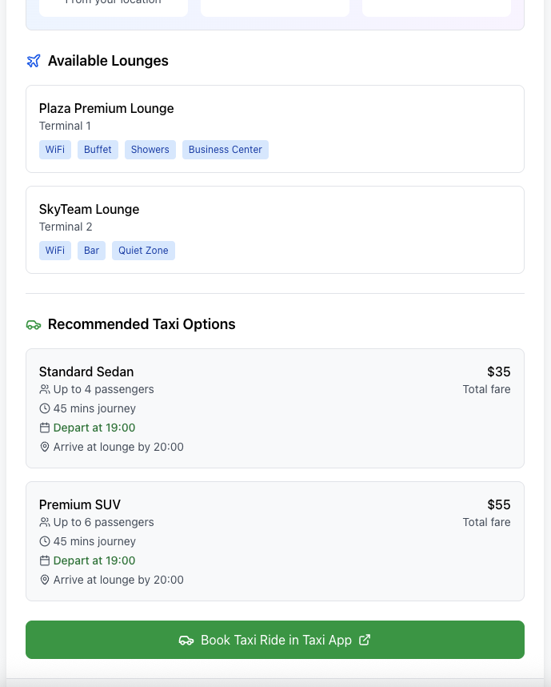

Slide 4
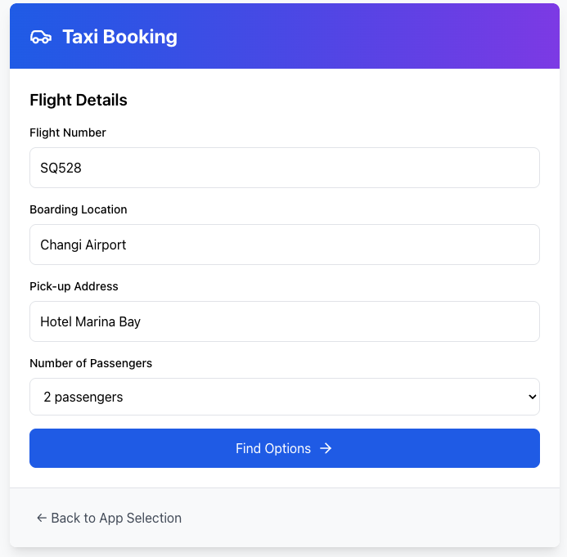

Slide 5
